Slide 1
Azure ML Machine Learning Model Production Case Study
Drew Minkin, Lead Data Science Instructor
Temitope Oyeleye, Data Science Immersive Student
June 14 2022

Slide 2
Data Science Process Phases
Business Understanding
Metric and Rationale
Data Profiling, Action Items for Business*
Modeling Phases
Diagnostic - Features removed if applicable
Feature Selection low ranking
Proxy variables
SME or other frame of reference on initial findings*
Baseline of performance
Pre-Residual Analysis: Initial Feature Engineering*
If time allows
Sampling Work - Minimum 2 rounds, Balancing
Post-Residual Analysis: Secondary Feature Engineering
Fine Tuning – Add Clustering Feature(s), Multi-Model *
Algorithm choices & Parameter Tuning
Cross validation
*- Data Acquisition & Understanding presented for Business Understanding
Copyright © 2022 Divergence Academy

Slide 3
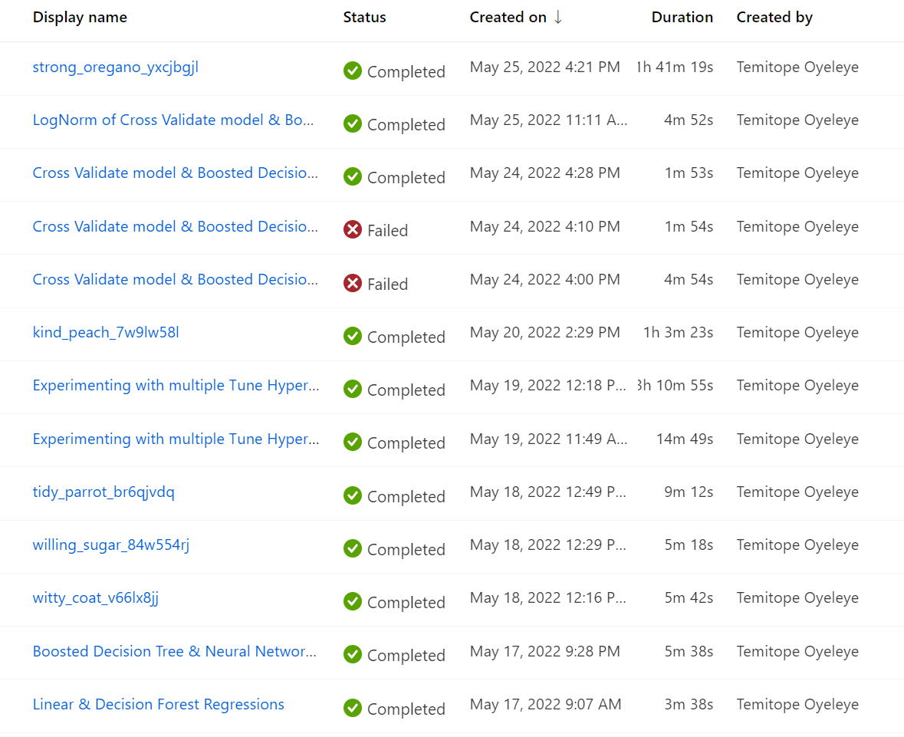

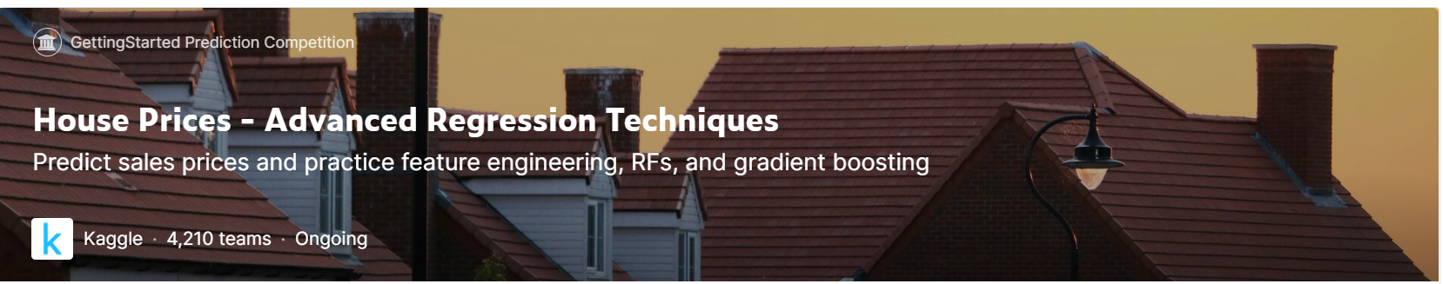
Case Study – Housing Prices
Kaggle Dataset
https://www.kaggle.com/competitions/house-prices-advanced-regression-techniques
Data Dictionary
80 columns
1,460 rows
All research authored by Temitope during Divergence Capstone May 17-25
Copyright © 2022 Divergence Academy

Slide 4
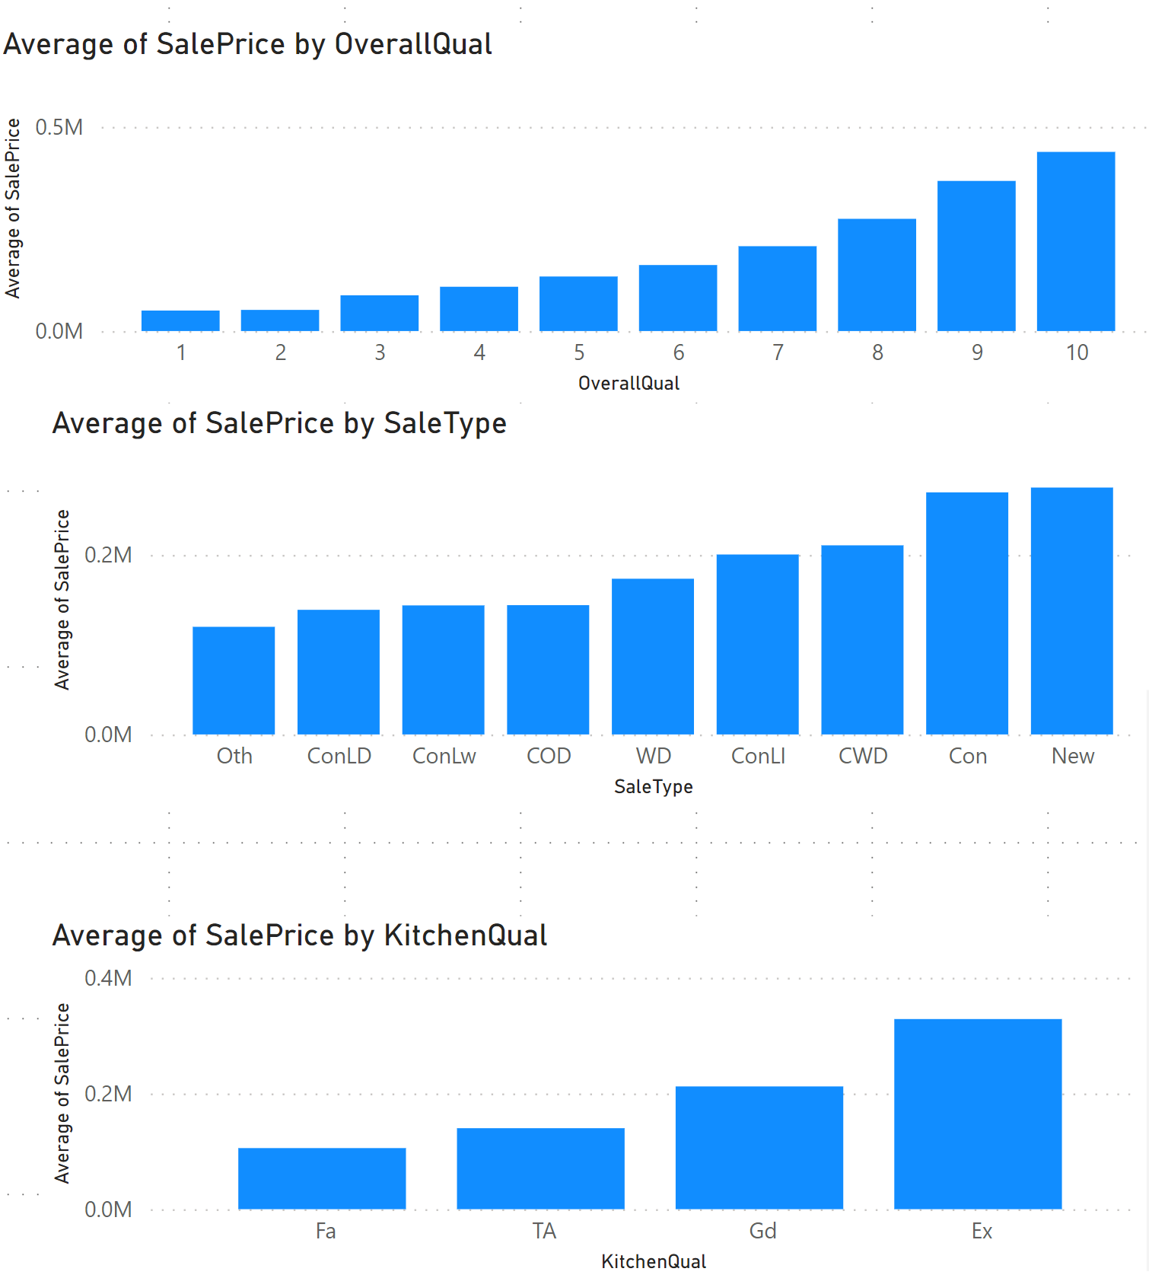
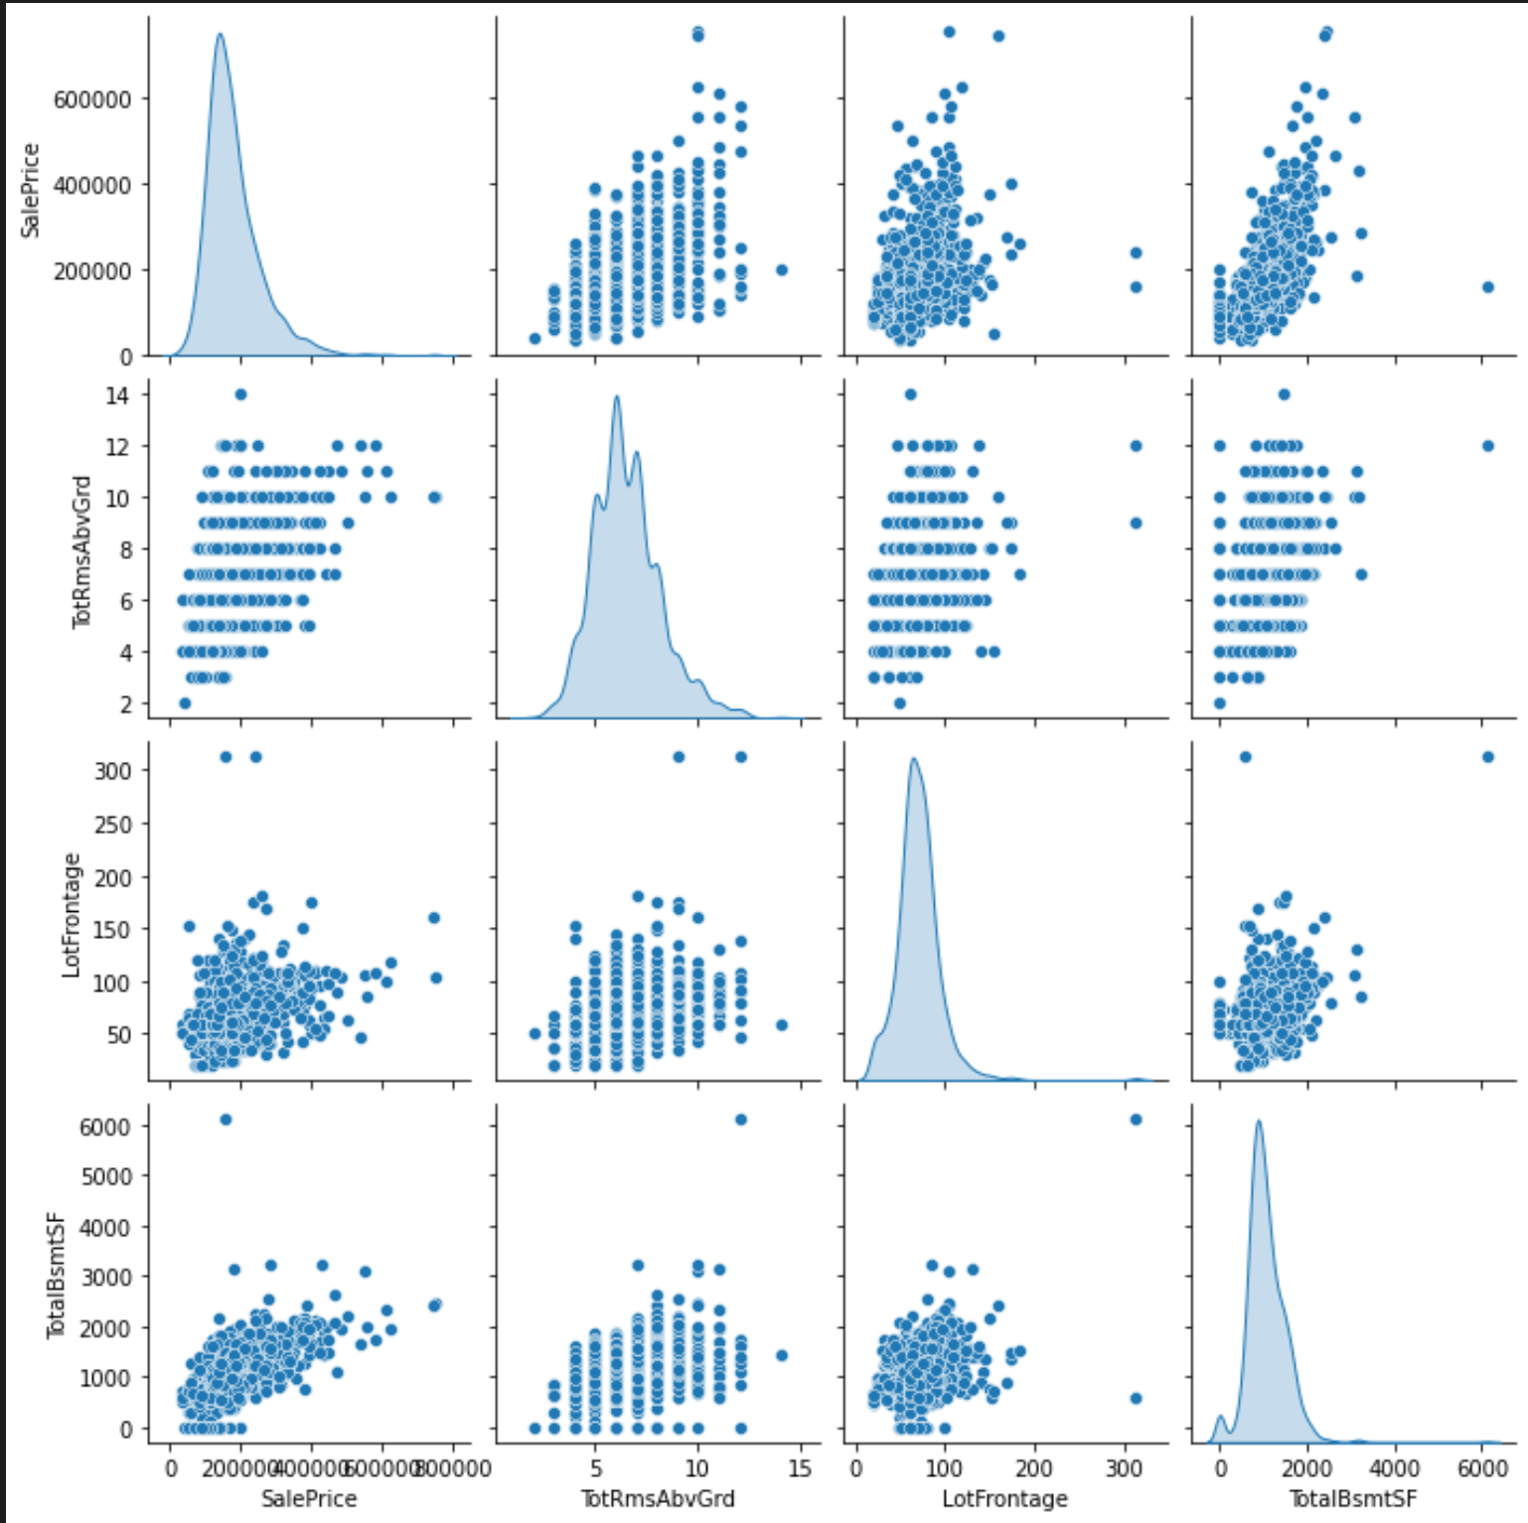
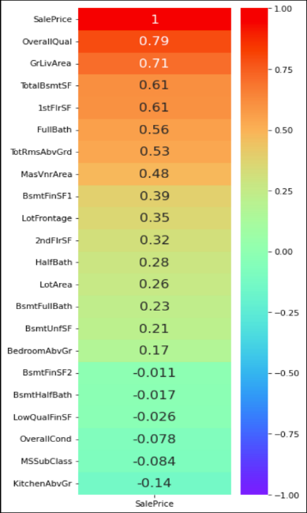
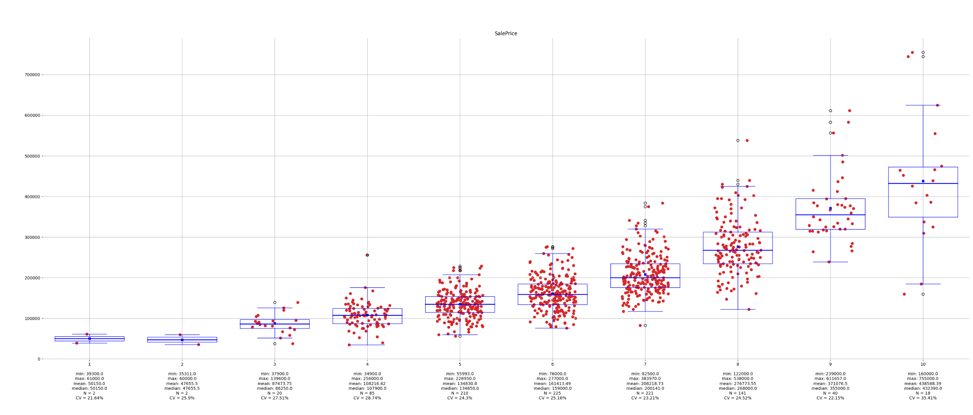
Initial Work – Exploratory Data Analysis
Data Acquisition & Understanding
Data Sources
Data Dictionary
Profile of data relevant to highlights
Preliminary analysis
Bivariate analysis
Scatter plots
Column charts
Histograms of interest
Constraints
Bad data encountered
Join mismatches
Outlier Analysis
Outliers found
Outlier Remediation
Cap/Filter/Transform
Any other BI insights
Copyright © 2022 Divergence Academy

Slide 5
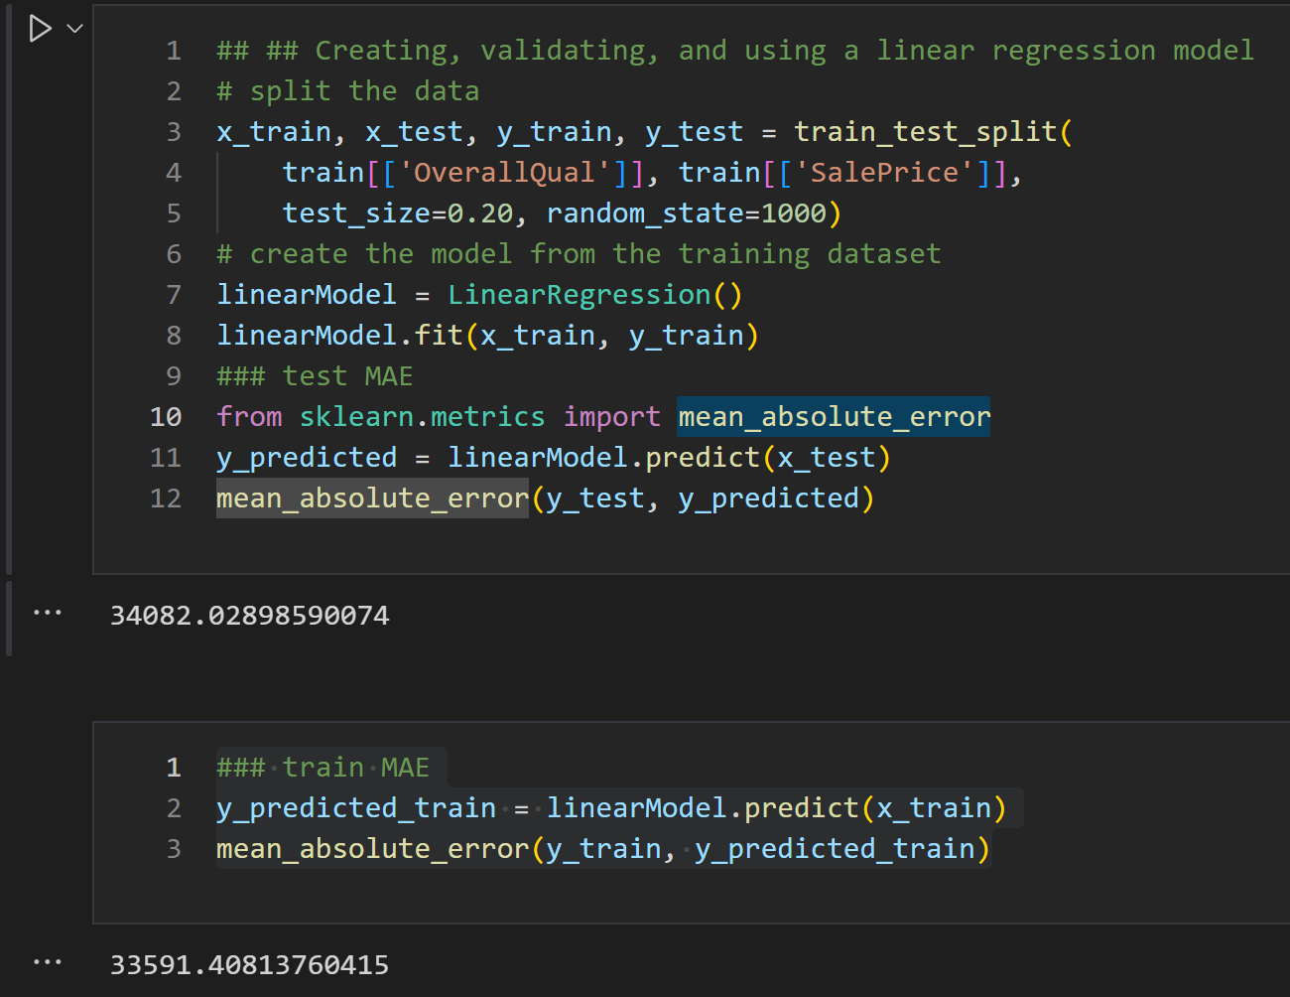
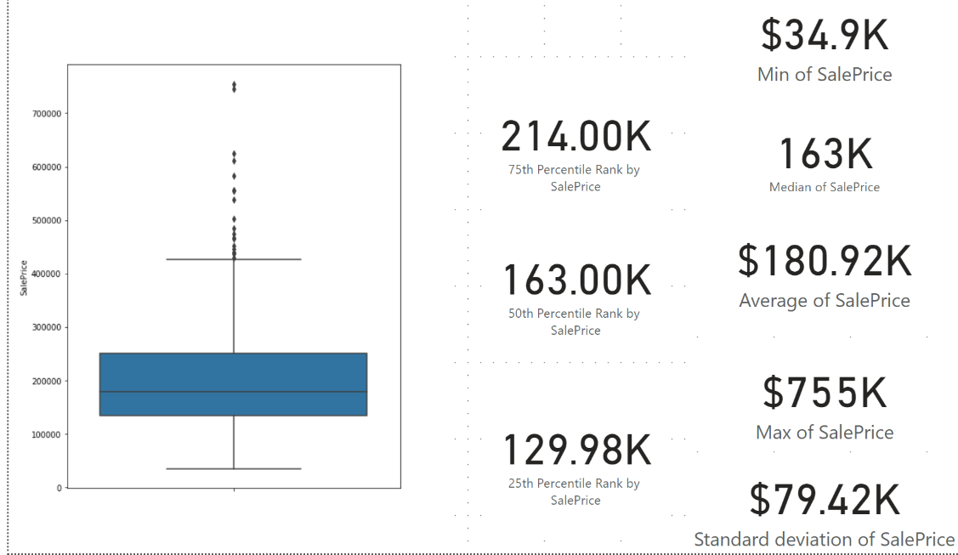
Phase 1: Initial Work – Baseline Linear Regression
Business Understanding
Metric and Rationale
Mean Absolute Error – no penalty, no translation
Modeling Phases
Diagnostic - Features removed if applicable
Baseline of performance
Copyright © 2022 Divergence Academy

Slide 6
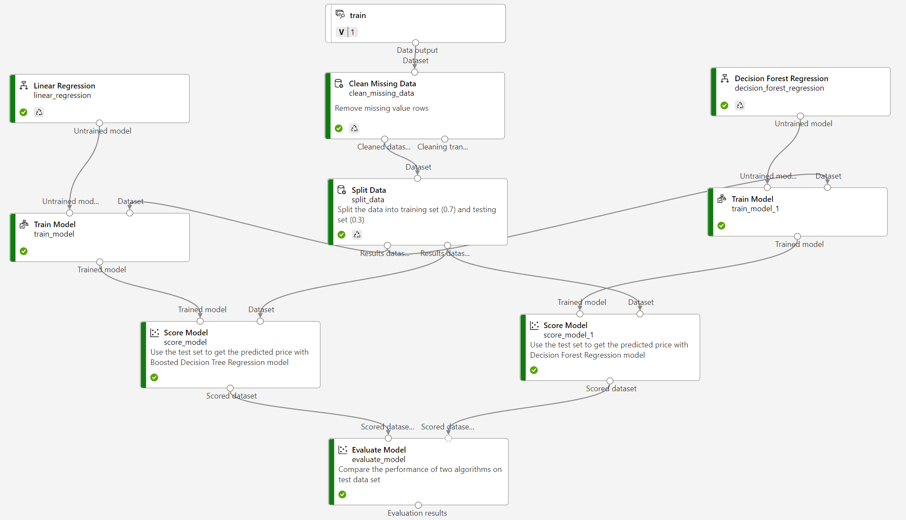
Phase 2: Diagnostic – Raw Feature Bakeoff Round 1
Minimally Viable Workflow
Metric and Rationale
Import Data
Clean Missing Data
Split Data
Choose Algorithm
Train Model
Score Model
Evaluate Model
Took best 2 of 4 algorithms for next round of modeling
Core Experiment
Secondary Experiment
Copyright © 2022 Divergence Academy

Slide 7
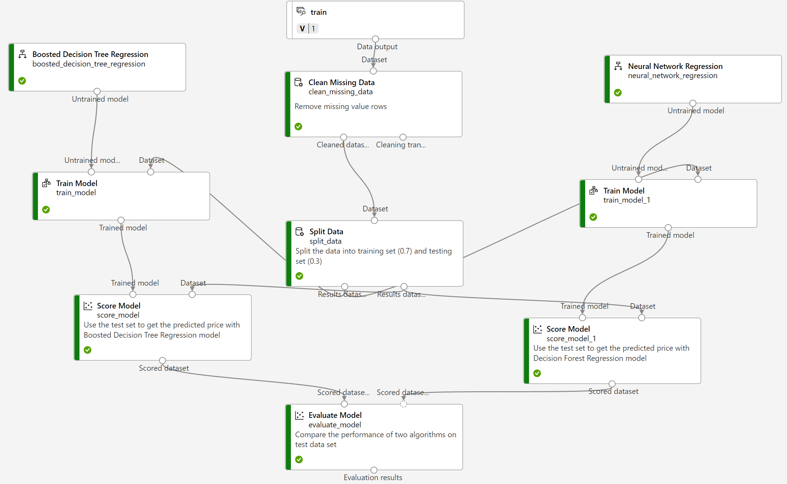
Phase 3: Diagnostic – Raw Feature Bakeoff Round 2
Repeat of Experiment
Same seed for Split so “apples to apples” comparison
Only change from previous run is other algorithms
Core Experiment
Secondary Experiment
Copyright © 2022 Divergence Academy

Slide 8
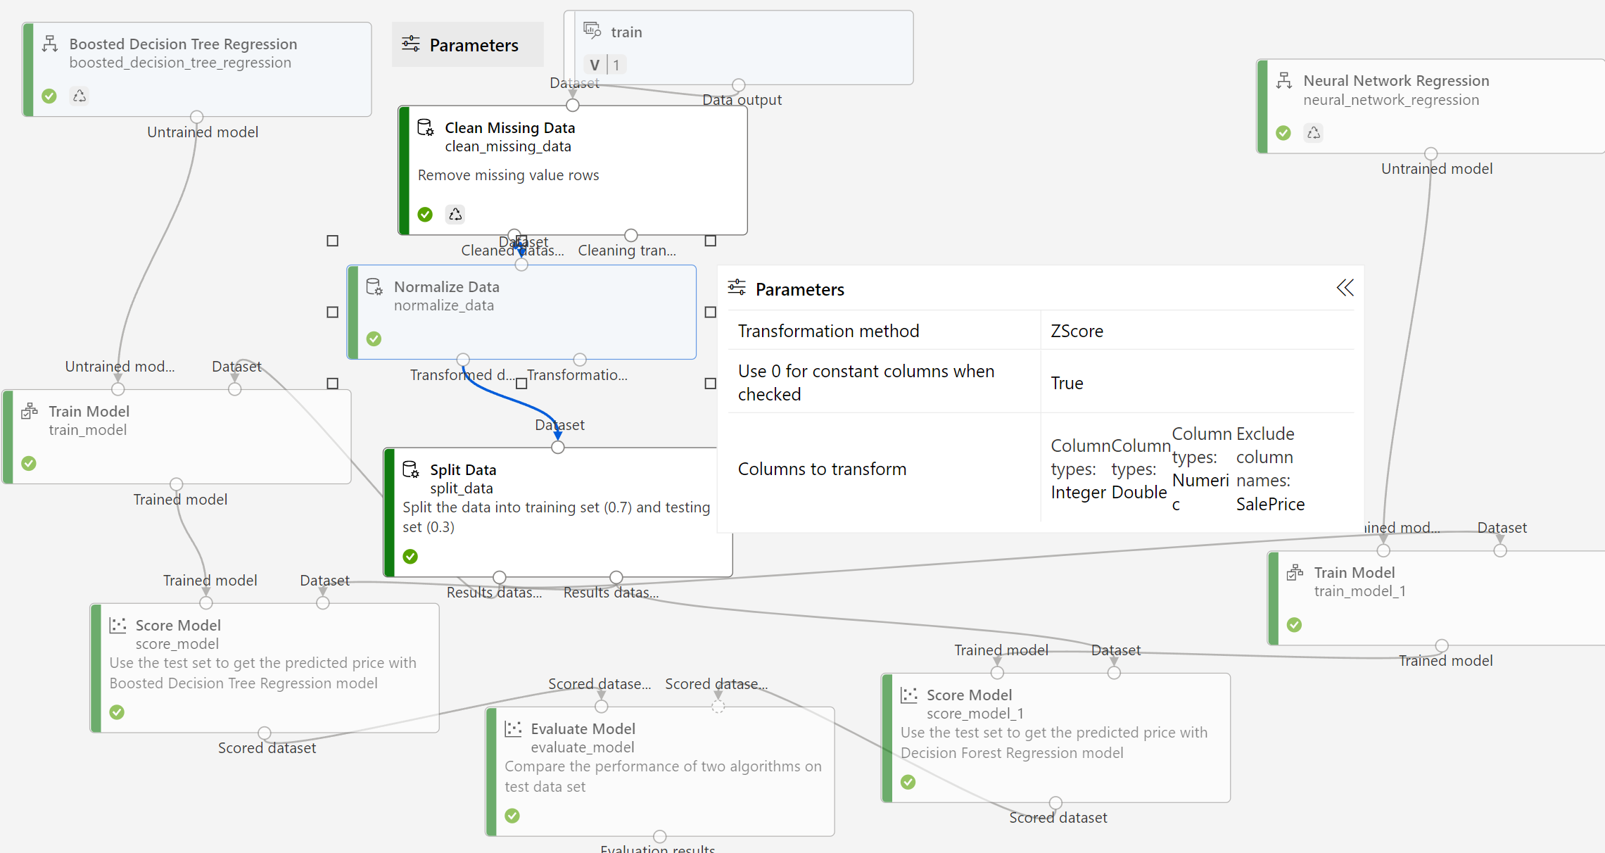
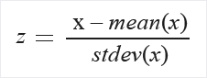
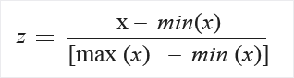
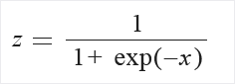
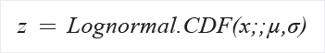
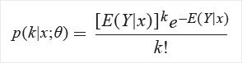
Phase 4&5: Pre-residual – Normalization Variation Part 1
Normalize Data
Zscore
MinMax
Logistic
LogNormal
TanH
Feature Engineering
Copyright © 2022 Divergence Academy
https://docs.microsoft.com/en-us/azure/machine-learning/component-reference/normalize-data

Slide 9
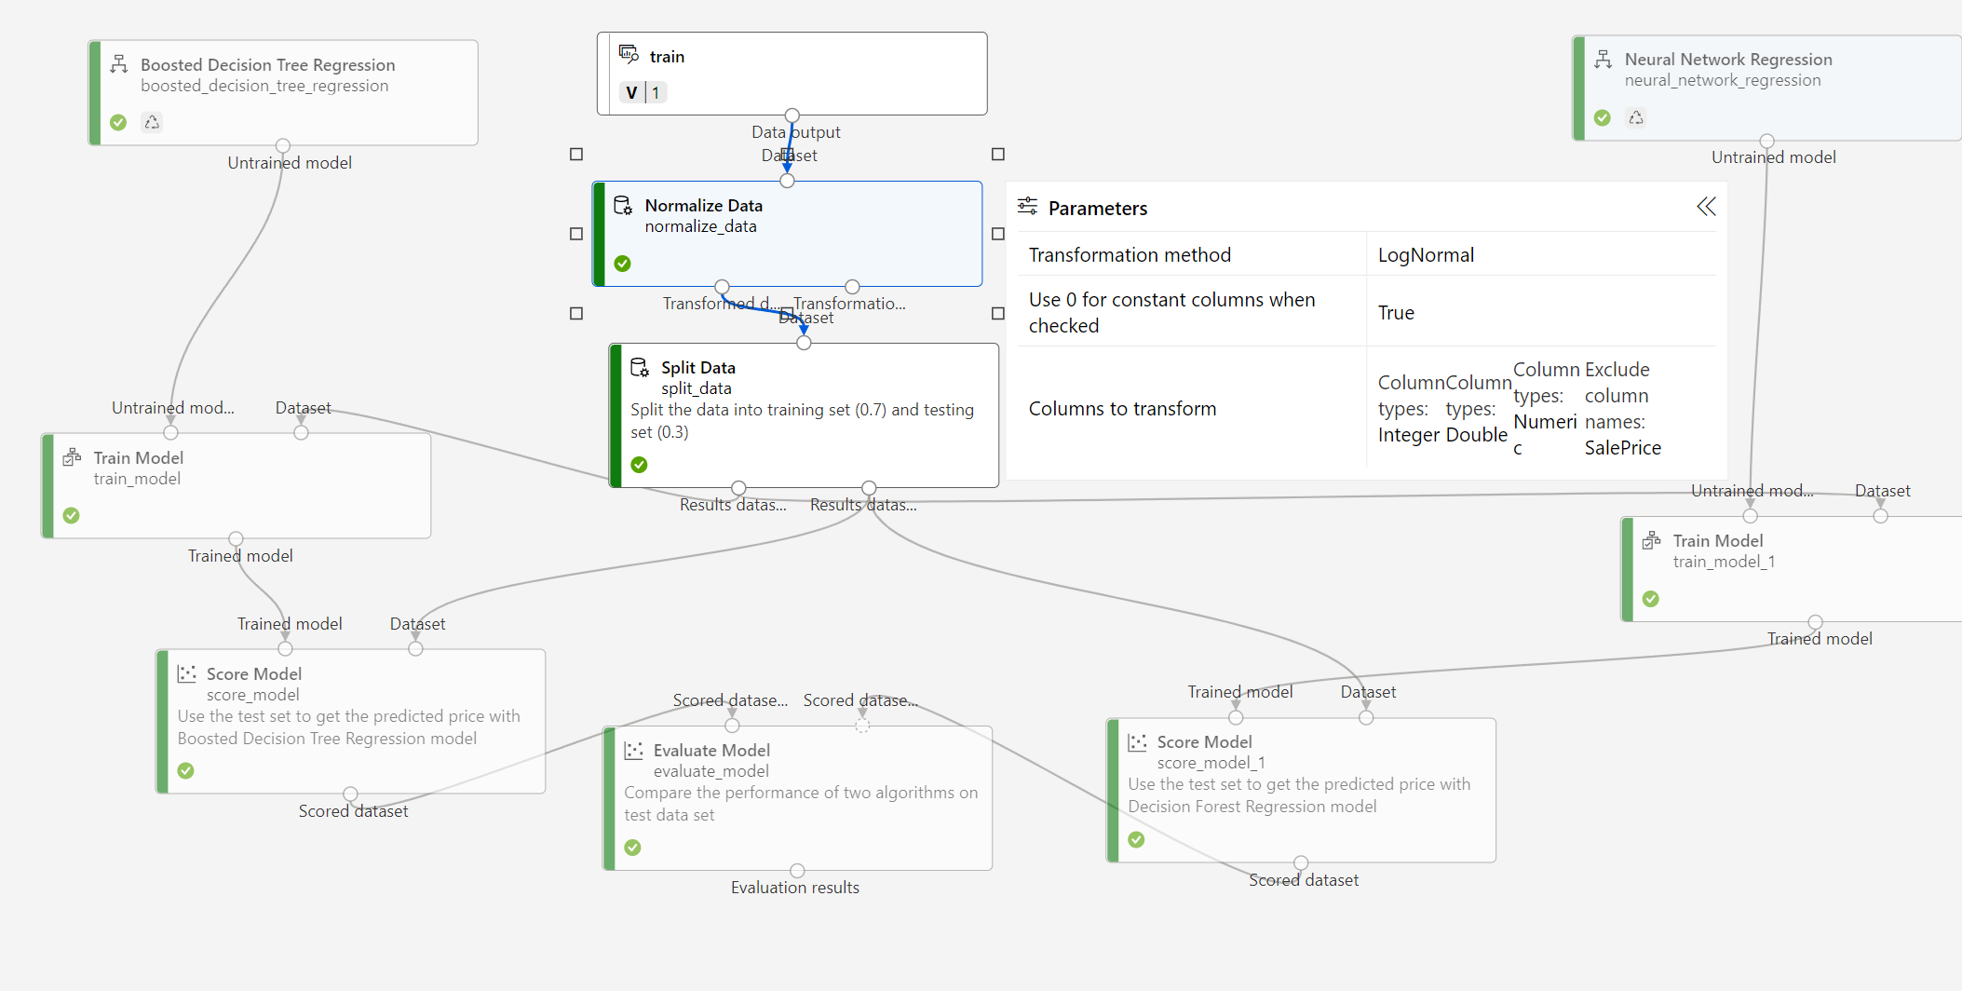
Phase 6: Pre-residual– Normalization Variation Part 2
Normalize Data
Zscore
MinMax
Logistic
LogNormal
TanH
Feature Engineering
Core Experiment
Copyright © 2022 Divergence Academy
https://docs.microsoft.com/en-us/azure/machine-learning/component-reference/normalize-data

Slide 10
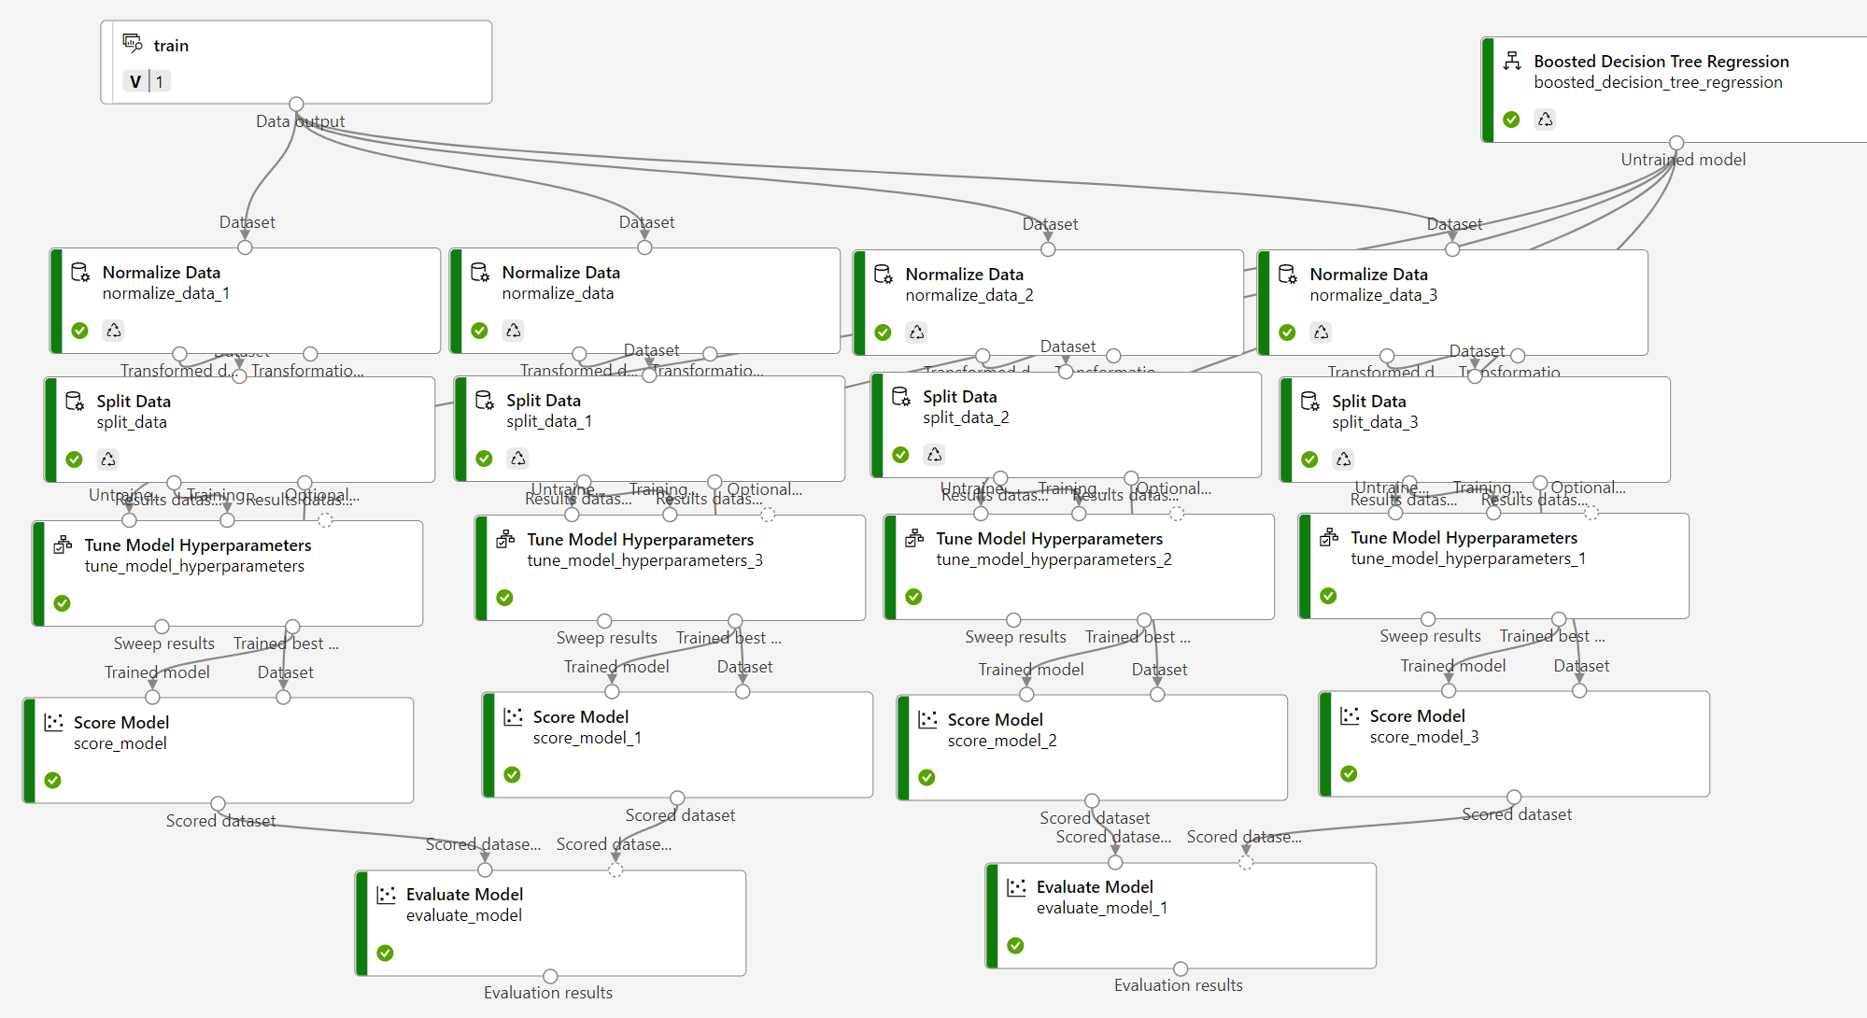
Phase 7: Tuning – Normalization + Hyperparameter Sweep
Tuning Phase I
Best algorithm of the four
Splits use same split
Basic sweep of 10 random hyperparameter configurations per feature engineering strategy
Feature Engineering
Feature Engineering
Core Experiment
Hyperparameter Sweep
Copyright © 2022 Divergence Academy
https://docs.microsoft.com/en-us/azure/machine-learning/component-reference/normalize-data

Slide 11
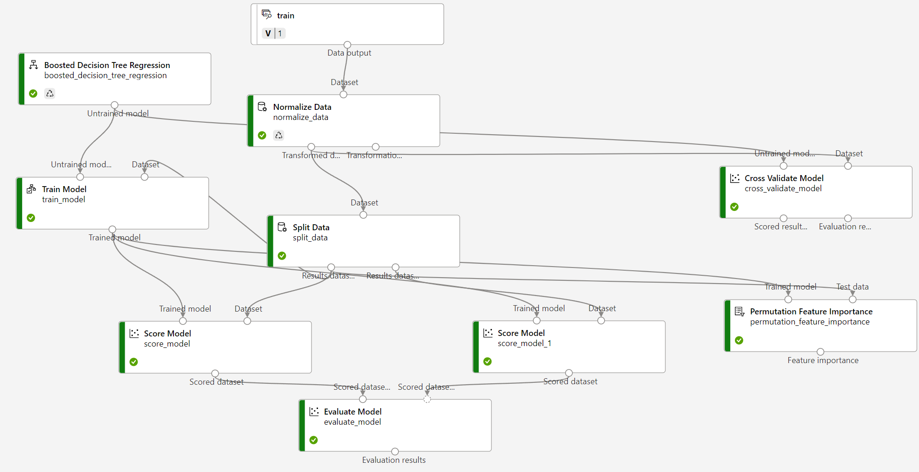
Phase 8&9: Tuning – Cross Validation & Feature Importance
Normalize Data Part II
Best algorithm of the four
Splits use same split
Two variations of normalization
Basic sweep of 10 random hyperparameter configurations per feature engineering strategy
Copyright © 2022 Divergence Academy

Slide 12
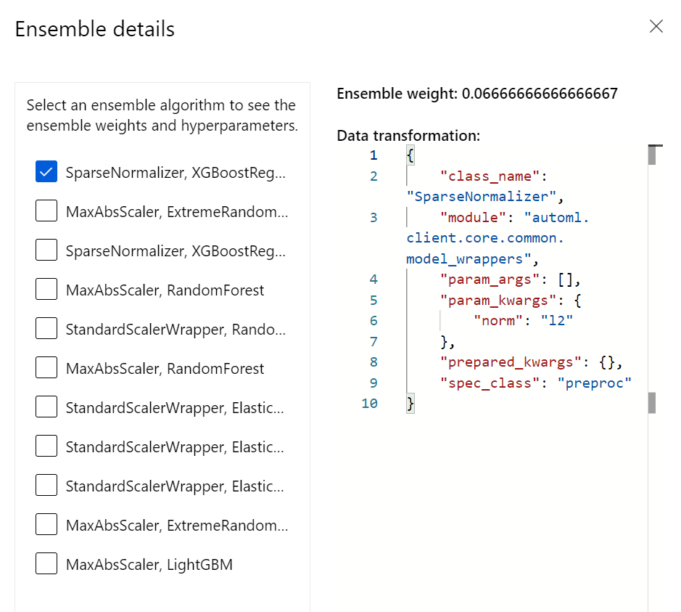
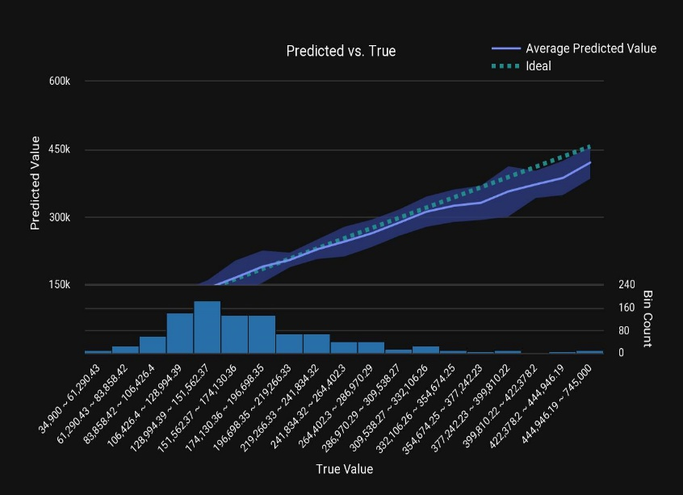
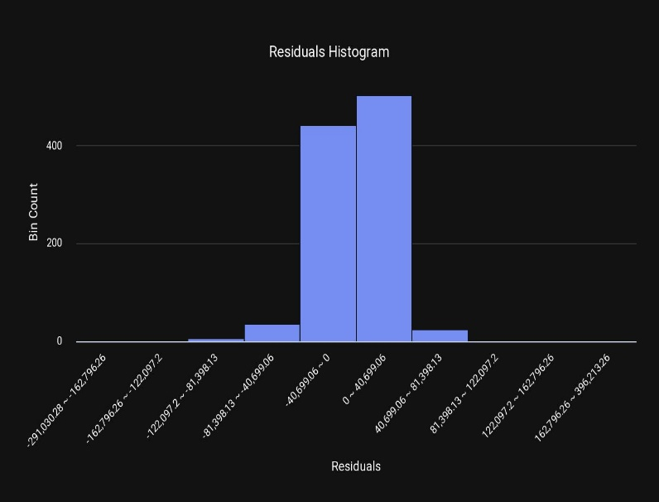
Phase 10: Tuning – AutoML Sanity Check
AutoML as Third Product
Used same training vs test splits
Ensemble of 11 different feature engineering & algorithm combinations
Copyright © 2022 Divergence Academy

Slide 13
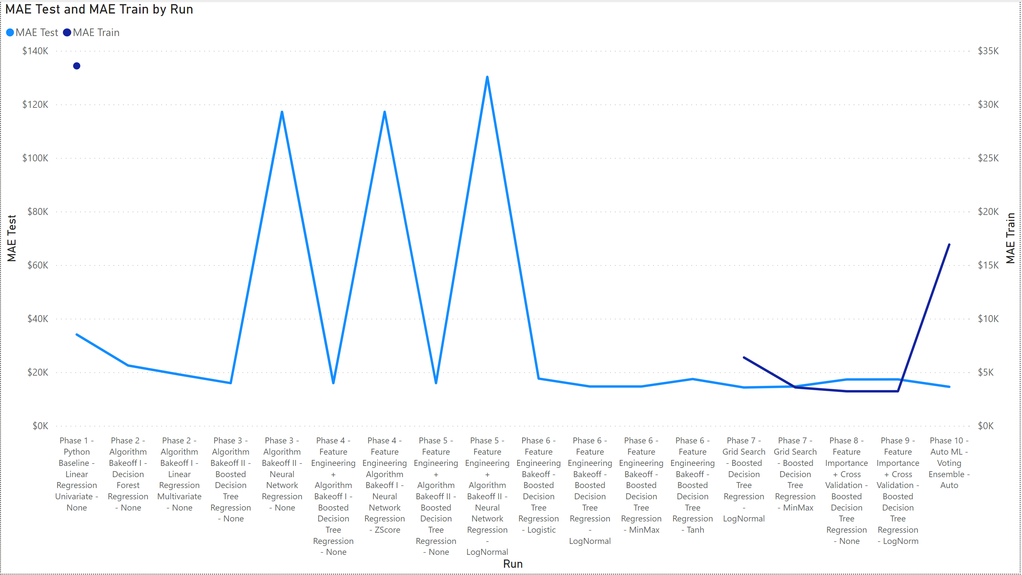
Conclusions
Good News
Significant drop in MAE through process
Manual model had comparable test perf without as much overfitting
Copyright © 2022 Divergence Academy

Slide 14
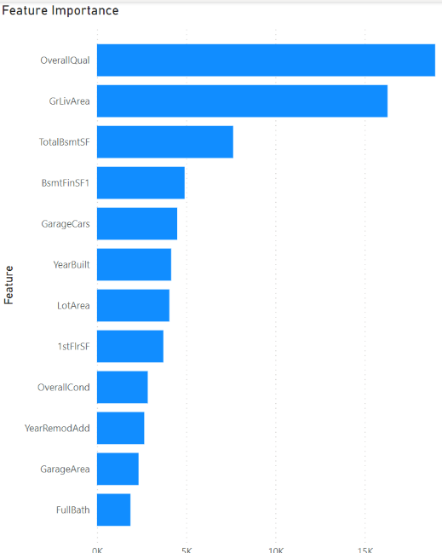
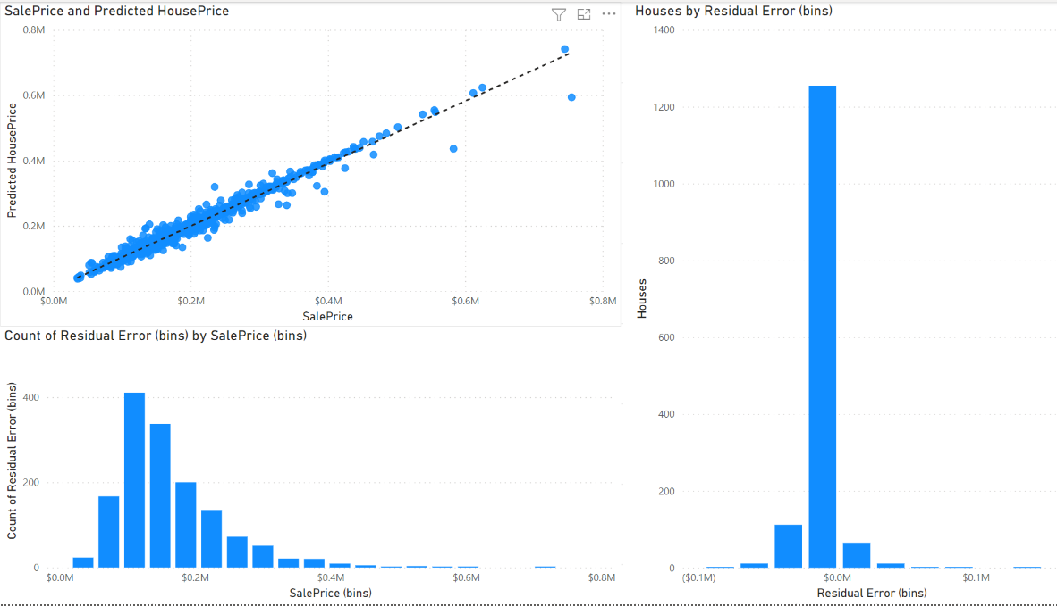
Conclusions
Bad News
8.1% coefficent of variance between model performance through cross-validation work
Additional work necessary on generalizing features ( binning, transforms, etc.) may reduce error
Copyright © 2022 Divergence Academy

Slide 15
Thank You
Looking Forward to Connecting!
14665 Midway Rd Suite 220, Addison, TX 75001
833-348-3743
hello@divergence.one
www.divergence.one

